Slide 1

Machine Learning
Day 7

Slide 2
Python - Modules
A module allows you to logically organize your Python code. Grouping related code into a module makes the code easier to understand and use. A module is a Python object with arbitrarily named attributes that you can bind and reference.
Simply, a module is a file consisting of Python code. A module can define functions, classes and variables. A module can also include runnable code.

Slide 3
Python - Modules
Create a Module
Save this code in a file named mymodule.py
def greeting(name): print("Hello, " + name)
Use a Module
Now we can use the module we just created, by using the import statement:
Example
Import the module named mymodule, and call the greeting function:
import mymodule mymodule.greeting("Jonathan")

Slide 4
Import with renaming
We can import a module by renaming it as follows.
# import module by renaming it
import math as m
print("The value of pi is", m.pi)
We have renamed the math module as m. This can save us typing time in some cases.

Slide 5
Import all names
We can import all names(definitions) from a module using the following construct.
# import all names from the standard module math
from math import *
print("The value of pi is", pi)
We imported all the definitions from the math module. This makes all names except those beginnig with an underscore, visible in our scope.
Importing everything with the asterisk (*) symbol is not a good programming practice. This can lead to duplicate definitions for an identifier. It also hampers the readability of our code.

Slide 6
The from import Statement
Python’s from statement lets you import specific attributes from a module.
The module named mymodule has one function and one dictionary:
def greeting(name): print("Hello, " + name) person1 = { "name": "John", "age": 36, "country": "Norway" }
Import only the person1 dictionary from the module:
from mymodule import person1 print (person1["age"])

Slide 7
Code Snippet illustrating python built-in modules:
import math
print(math.sqrt(25))
print(math.pi)
print(math.degrees(2))
print(math.radians(60))
print(math.sin(2))
print(math.cos(0.5))
print(math.tan(0.23))
print(math.factorial(4))

Slide 8
Packages in Python
We don't usually store all of our files in our computer in the same location. We use a well-organized hierarchy of directories for easier access.
Similar files are kept in the same directory, for example, we may keep all the songs in the "music" directory. Analogous to this, Python has packages for directories and modules for files.
As our application program grows larger in size with a lot of modules, we place similar modules in one package and different modules in different packages. This makes a project (program) easy to manage and conceptually clear.
Similar, as a directory can contain sub-directories and files, a Python package can have sub-packages and modules.

Slide 9
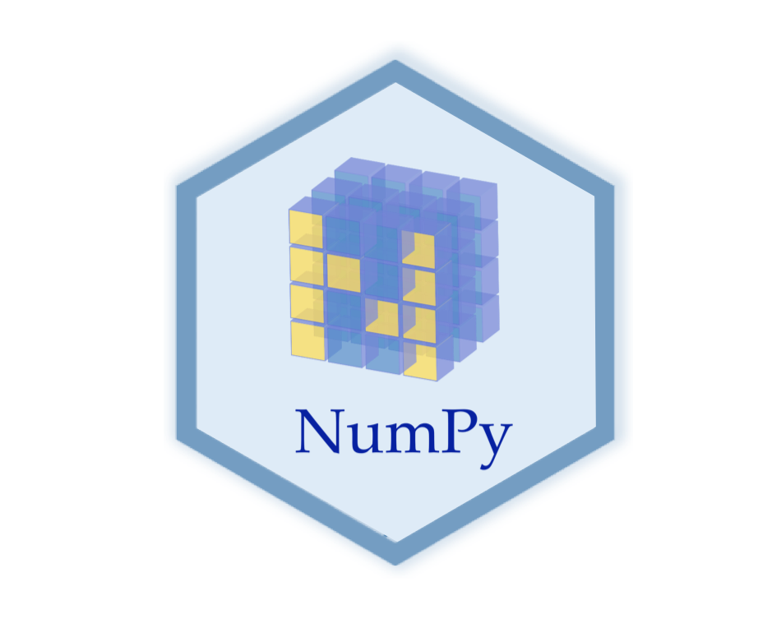

Slide 10
What is Numpy
NumPy stands for numeric python which is a python package for the computation and processing of the multidimensional and single dimensional array elements.
Travis Oliphant created NumPy package in 2005 by injecting the features of the ancestor module Numeric into another module Numarray.

Slide 11
Why Numpy
With the revolution of data science, data analysis libraries like NumPy, SciPy, Pandas, etc. have seen a lot of growth. With a much easier syntax than other programming languages, python is the first choice language for the data scientist.
NumPy provides a convenient and efficient way to handle the vast amount of data. NumPy is also very convenient with Matrix operations and data reshaping. NumPy is fast which makes it reasonable to work with a large set of data.

Slide 12
Why Numpy
There are the following advantages of using NumPy for data analysis.
NumPy performs array-oriented computing.
It efficiently implements the multidimensional arrays.
It performs scientific computations.
It is capable of reshaping the data stored in multidimensional arrays.

Slide 13
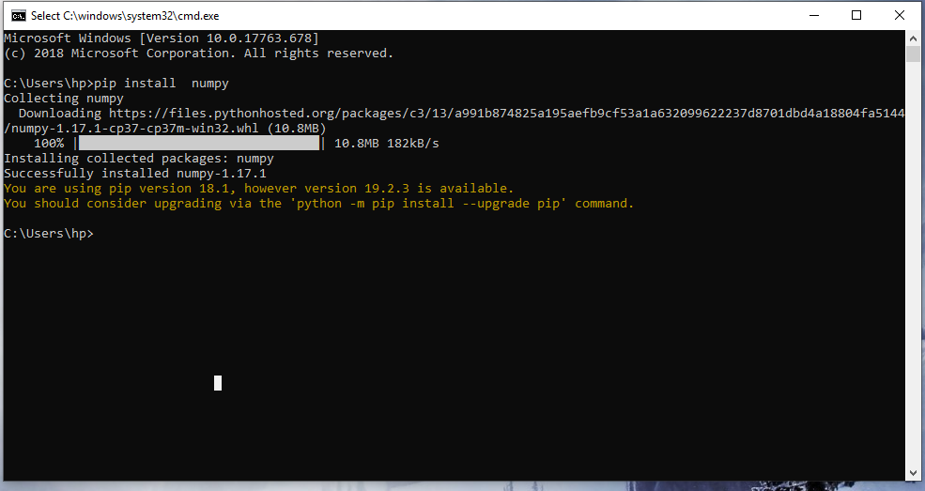
Numpy Environment Setup
NumPy doesn't come bundled with Python. We have to install it by using following step
Open “cmd”
Type “ pip install numpy” on cmd then press enter.

Slide 14
Numpy Ndarray
Ndarray is the n-dimensional array object defined in the numpy which stores the collection of the similar type of elements. In other words, we can define a ndarray as the collection of the data type (dtype) objects.
The ndarray object can be accessed by using the 0 based indexing. Each element of the Array object contains the same size in the memory.

Slide 15
Creating Ndarray
To create an array using the list, use the following syntax.
import numpy as np
a = np.array([value1,value2,………])
print (a)

Slide 16
Creating Ndarray
To create a multi-dimensional array object, use the following syntax.
# more than one dimensions
import numpy as np
a = np.array([[values…..], [values…..]])

Slide 17
Finding the size of each array element
The itemsize function is used to get the size of each
array item. It returns the number of bytes taken by
each array element.
Syntax:
array.itemsize

Slide 18
Finding the size of each array element
Example
#finding the size of each item in the array
import numpy as np
a = np.array([[1,2,3]])
print("Each item contains",a.itemsize,"bytes")
Output:
Each item contains 4 bytes.

Slide 19
Finding the data type of each array item
To check the data type of each array item, the dtype
function is used. Consider the following example to
check the data type of the array items.
Example
#finding the data type of each array item
import numpy as np
a = np.array([[1,2,3]])
print("Each item is of the type",a.dtype)
Result: Each item is the type of int32

Slide 20
Finding the shape and size of the array
To get the shape and size of the array, the size and shape function associated with the numpy array is used.
ndarray.shape():
Example
import numpy as np
a = np.array([[1,2,3,4,5,6,7]])
print("Shape:",a.shape)
Output:
Shape: (1, 7)

Slide 21
Finding the shape and size of the array
To get the shape and size of the array, the size and shape function associated with the numpy array is used.
ndarray.size():
Example
import numpy as np
a = np.array([[1,2,3,4,5,6,7]])
print("Array Size:",a.size)
Output:
Array Size: 7

Slide 22
Reshaping the array objects
By the shape of the array, we mean the number of rows and columns of a multi-dimensional array.
However, the numpy module provides us the way to
reshape the array by changing the number of rows
and columns of the multi-dimensional array.
.

Slide 23
Reshaping the array objects
The reshape() function associated with the ndarray object is used to reshape the array. It accepts the two parameters indicating the row and columns of the new shape of the array
Syntax: numpy.reshape(a, newshape,)
This function helps to get a new shape to an array without changing its data.

Slide 24
Reshaping the array objects
Let's reshape the array given in the following image.

Slide 25
Reshaping the array objects
Example
import numpy as np
a = np.array([[1,2],[3,4],[5,6]])
print("printing the original array..")
print(a)
a=a.reshape(2,3)
print("printing the reshaped array..")
print(a)

Slide 26
Reshaping the array objects
Output:
printing the original array.. [[1 2] [3 4] [5 6]]
printing the reshaped array.. [[1 2 3] [4 5 6]]

Slide 27
Slicing in the Array
Consider the following example to print a particular element of the array.
Example
import numpy as np
a = np.array([[1,2],[3,4],[5,6]])
print(a[0,1])
print(a[2,0])
Output:
2 5
The above program prints the 2nd element from the 0th index and 0th element from the 2nd index of the array.

Slide 28
Finding the maximum, minimum, and sum of the array elements
The NumPy provides the max(), min(), and sum() functions which are used to find the maximum, minimum, and sum of the array elements respectively.
max()
Max function is used to display largest value from a given array list.
a = np.array([1,2,3,10,15,4])
print("The maximum element:",a.max())

Slide 29
Finding the maximum, minimum, and sum of the array elements
min()
min function is used to dispay smallest value from a given array list.
a = np.array([1,2,3,10,15,4])
print("The minimum element:",a.min())
sum()
sum function is used to display total of the values.
a = np.array([1,2,3,10,15,4])
print("The sum is :",a.sum())

Slide 30
NumPy Array Axis
A NumPy multi-dimensional array is represented by the axis where axis-0 represents the columns and axis-1 represents the rows.

Slide 31
NumPy Array Axis
To calculate the maximum element among each column.
consider the following example.
Example
a = np.array([[1,2,30],[10,15,4]])
print("The maximum elements of columns:",a.max(axis = 0))
Output:
maximum elements of columns: [10 15 30] .

Slide 32
Finding square root and standard deviation
The sqrt() and std() functions associated with the numpy array are used to find the square root and standard deviation of the array elements respectively. Standard deviation means how much each element of the array varies from the mean value of the numpy array.
Syntax:
numpy.sqrt or std(array_name))

Slide 33
Arithmetic operations on the array
The numpy module allows us to perform the arithmetic operations on multi-dimensional arrays directly.
Example
import numpy as np
a = np.array([[1,2,30],[10,15,4]])
b = np.array([[1,2,3],[12, 19, 29]])
print("Sum of array a and b\n",a+b)

Slide 34
Array Concatenation
The numpy provides us with the vertical stacking and horizontal stacking which allows us to concatenate two multi-dimensional arrays vertically or horizontally.
Consider the following example.
Example
import numpy as np
a = np.array([[1,2,30],[10,15,4]])
b = np.array([[1,2,3],[12, 19, 29]])

Slide 35
Array Concatenation
print("Arrays vertically concatenated\n",np.vstack((a,b)));
print("Arrays horizontally concatenated\n",np.hstack((a,b)))
Output:
Arrays vertically concatenated [[ 1 2 30] [10 15 4] [ 1 2 3] [12 19 29]]
Arrays horizontally concatenated [[ 1 2 30 1 2 3] [10 15 4 12 19 29]]

Slide 36
Numpy Array Creation
The ndarray object can be constructed by using the following routines.
Numpy.empty
As the name specifies, The empty routine is used to create an uninitialized array of specified shape and data type.
The syntax is given below.
numpy.empty(shape, dtype = float, order = 'C')
Shape: The desired shape of the specified array.

Slide 37
Numpy Array Creation
dtype: The data type of the array items. The default is the float.
Order: The default order is the c-style row-major order. It can be set to F for FORTRAN-style column-major order.
Example
import numpy as np
arr = np.empty((3,2), dtype = int)
print(arr)

Slide 38
Numpy Array Creation
Output:
[[ 140482883954664 36917984] [ 140482883954648 140482883954648] [6497921830368665435 172026472699604272]]

Slide 39
Numpy Array Creation
NumPy.Zeros: This routine is used to create the numpy array with the specified shape where each numpy array item is initialized to 0.
The syntax is given below.
numpy.zeros(shape, dtype = float, order = 'C')
It accepts the following parameters.
Shape: The desired shape of the specified array.
dtype: The data type of the array items. The default is the float.

Slide 40
Numpy Array Creation
Order: The default order is the c-style row-major order. It can be set to F for FORTRAN-style column-major order.
Example
import numpy as np
arr = np.zeros((3,2), dtype = int)
print(arr)
Output:
[[0 0] [0 0] [0 0]]

Slide 41
Numpy Array Creation
NumPy.ones
This routine is used to create the numpy array with the specified shape where each numpy array item is initialized to 1.
The syntax to use this module is given below.
numpy.ones(shape, dtype = none, order = 'C')
All parameter are same as previous order.

Slide 42
Numpy array from existing data
numpy.asarray
This routine is used to create an array by using the existing data in the form of lists, or tuples. This routine is useful in the scenario where we need to convert a python sequence into the numpy array object.
Syntax:
numpy.asarray(sequence, dtype = None, order = None)

Slide 43
Numpy array from existing data
It accepts the following parameters.
sequence: It is the python sequence which is to be converted into the python array.
dtype: It is the data type of each item of the array.
order: It can be set to C or F. The default is C.

Slide 44
Numpy array from existing data
Example:
creating a numpy array using Tuple
import numpy as np
l=(1,2,3,4,5,6,7)
a = np.asarray(l);
print(type(a))
print(a)
Output:
<class 'numpy.ndarray'> [1 2 3 4 5 6 7]

Slide 45
Numpy Arrays within the numerical range
numpy.arange(start, stop, step, dtype)
It accepts the following parameters.
start: The starting of an interval. The default is 0.
stop: represents the value at which the interval ends excluding this value.
step: The number by which the interval values change.
dtype: the data type of the numpy array items.
group

Slide 46
NumPy Broadcasting
In Mathematical operations, we may need to consider the arrays of different shapes. NumPy can perform such operations where the array of different shapes are involved.
For example, if we consider the matrix multiplication operation, if the shape of the two matrices is the same then this operation will be easily performed. However, we may also need to operate if the shape is not similar.

Slide 47
NumPy Broadcasting
Consider the following example to multiply two arrays.
Example
import numpy as np
a = np.array([1,2,3,4,5,6,7])
b = np.array([2,4,6,8,10,12,14])
c = a*b;
print(c) //result [ 2 8 18 32 50 72 98]

Slide 48
NumPy Broadcasting
In the last example, we can see that the shapes of the two arrays are not similar and therefore they cannot be multiplied together. NumPy can perform such operation by using the concept of broadcasting.
In broadcasting, the smaller array is broadcast to the larger array to make their shapes compatible with each other.

Slide 49
NumPy Broadcasting
Example
import numpy as np
a = np.array([[1,2,3,4],[2,4,5,6],[10,20,39,3]])
b = np.array([2,4,6,8])
print("\nAdding arrays a and b ..")
c = a + b;
print(c)
Output: Adding arrays a and b ..[[ 3 6 9 12] [ 4 8 11 14][12 24 45 11]]

Slide 50
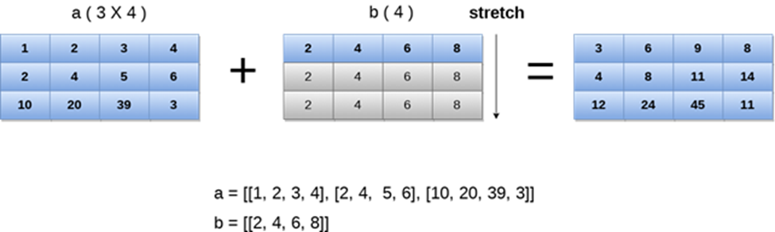
NumPy Broadcasting

Slide 51
NumPy Array Iteration
NumPy provides an iterator object, i.e., nditer which can be used to iterate over the given array using python standard Iterator interface.
Consider the following example.
Example
import numpy as np
a = np.array([[1,2,3,4],[2,4,5,6],[10,20,39,3]])
print("Printing array:")

Slide 52
NumPy Array Iteration
print(a);
print("Iterating over the array:")
for x in np.nditer(a):
print(x,end=' ')
Output:
Printing array: [[ 1 2 3 4] [ 2 4 5 6] [10 20 39 3]] Iterating over the array: 1 2 3 4 2 4 5 6 10 20 39 3

Slide 53
Order of Iteration
As we know, there are two ways of storing values into the numpy arrays:
F-style order
C-style order

Slide 54
NumPy Mathematical Functions
Trigonometric functions
Numpy contains the trigonometric functions which are used to calculate the sine, cosine, and tangent of the different angles in radian. The sin, cos, and tan functions return the trigonometric ratio for the specified angles.

Slide 55
Example
import numpy as np
arr = np.array([0, 30, 60, 90, 120, 150, 180])
print("\nThe sin value of the angles",end = " ")
print(np.sin(arr * np.pi/180))
print("\nThe cosine value of the angles",end = " ")
print(np.cos(arr * np.pi/180))
print("\nThe tangent value of the angles",end = " ")
print(np.tan(arr * np.pi/180))

Slide 56
Rounding Functions
numpy.around()
This function returns a decimal value rounded to a desired position of the decimal.
Syntax: numpy.around(num, decimals)
num: It is the input number.
decimals: It is the number of decimals which to which the number is to be rounded.
The default value is 0. If this value is negative, then the decimal will be moved to the left.

Slide 57
import numpy as np
arr = np.array([12.202, 90.23120, 123.020, 23.202])
print("printing the original array values:",end = " ")
print(arr)
print("Array values rounded off to 2 decimal position",np.around(arr, 2))
print("Array values rounded off to -1 decimal position",np.around(arr, -1))

Slide 58
The numpy.floor() function
This function is used to return the floor value of the input data which is the largest integer not greater than the input value.
Example
import numpy as np
arr = np.array([12.202, 90.23120, 123.020, 23.202])
print(np.floor(arr))

Slide 59
The numpy.ceil() function
This function is used to return the ceiling value of the array values which is the smallest integer value greater than the array element.
Example
import numpy as np
arr = np.array([12.202, 90.23120, 123.020, 23.202])
print(np.ceil(arr))

Slide 60
Numpy statistical functions
The numpy.amin() and numpy.amax()
These functions are used to find the minimum and maximum of the array elements along the specified axis respectively.
Syntax: amin(array_name, axis)
amax(array_name, axis)
The axis will be
1: for row wise operation
0: for column wise operation

Slide 61
Example:
a = np.array([[2,10,20],[80,43,31],[22,90,18]])
print("The original array:\n")
print(a)
print("\nThe minimum element among the columns of array",np.amin(a,0))
print("The maximum element among the columns of array",np.amax(a,0))
print("\nThe minimum element among the rows of array",np.amin(a,1))
print("The maximum element among the rows of array",np.amax(a,1))

Slide 62
numpy.ptp() function
The name of the function numpy.ptp() is derived from the name peak-to-peak. It is used to return the range of values along an axis.
Syntax: numpy.ptp(array, axis)
Range=max value-min value
Example
import numpy as np
a = np.array([[2,10,20],[80,43,31],[22,43,10]])
print("Original array:\n",a)
print(“Row wise range:",np.ptp(a,1))
print(“Column wise range:",np.ptp(a,0))

Slide 63
The numpy.median() function:
Median is defined as the value that is used to separate the higher range of data sample with a lower range of data sample. The Median is the "middle" of a sorted list of numbers.
numpy.median(): used to calculate the median of the multi-dimensional or one-dimensional arrays.
Syntax: numpy.median(array_name,axis)
The numpy.mean() function:
The mean can be calculated by adding all the items of the arrays dividing by the number of array elements.
Syntax: numpy.mean(array_name,axis)

Slide 64
NumPy Sorting and Searching
Numpy provides a variety of functions for sorting and searching. There are various sorting algorithms like quicksort, merge sort and heapsort which is implemented using the numpy.sort() function.
SN | Algorithm
1 | Quick Sort
2 | Merge Sort
3 | Heap Sort

Slide 65
Syntax:
numpy.sort(a, axis, kind, order)
Parameter | Description
input | It represents the input array which is to be sorted.
axis | 0- column wise operation 1- row wise operation Default: row wise
kind | It represents the type of sorting algorithm. The default is quick sort.
order | It represents the filed according to which the array is to be sorted in the case if the array contains the fields.

Slide 66
Example:
a = np.array([[2,45,20],[80,43,31],[22,90,18]])
print(np.sort(a)) #row wise sorting
Print(“Column wise Sorting”, np.sort(a,0))

Slide 67
numpy.argsort() function
It returns an array of index of sorted data.
Example:
sort_ind = np.argsort(a)
print("Printing indices of sorted data\n",sort_ind)

Slide 68
np.log()
Calculates the natural log of an array.
np.log(array)

Slide 69
numpy.nonzero()
This function is used to find the location of the non-zero elements from the array.
Example
b = np.array([12, 90, 380, 12, 211])
print("printing location of the non-zero elements")
print(b.nonzero())

Slide 70
Array Assignment
The assignment of a numpy array to another array, it represents the reference to the original array. Changes made on this reference are also reflected in the original array.
Example
ap = np.array([2,45,20])
ar=ap
ar[1]=900
print(ap) # will display 2, 900,20

